Slide 1
Artificial Intelligence (AI)
Topic 2: Problem Solving Agents

Slide 2
Agenda
Problem-solving agents
Problem types
Problem formulation
Example problems
Basic search algorithms
Learning Outcomes : Intelligent Agents
Methodology and Assessment Criteria for the Subject

Slide 3
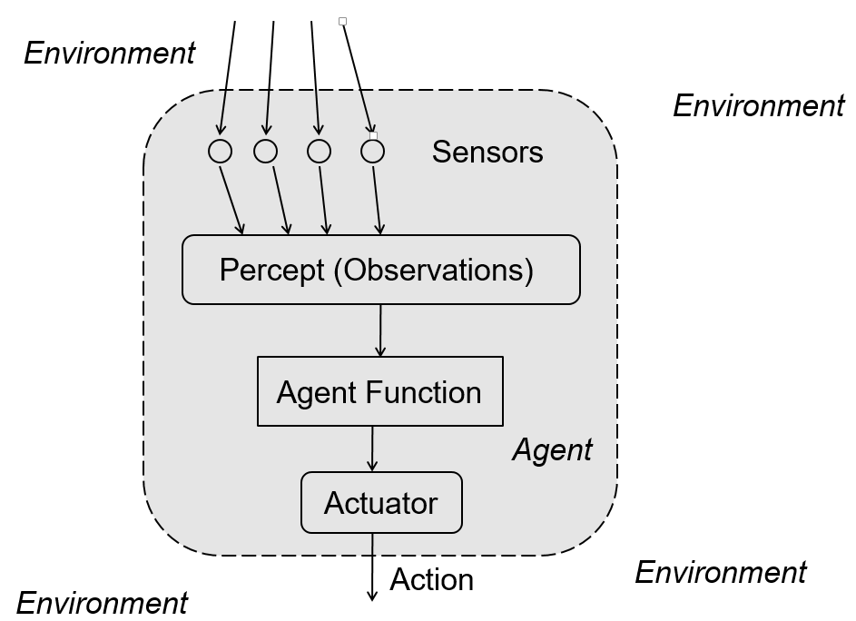

Slide 4
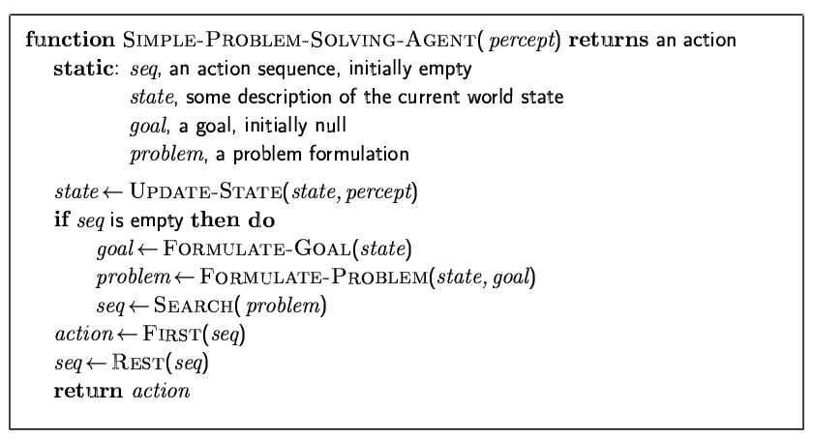
Problem Solving Agents (1)

Slide 5
Problem Solving Agents (2)
Problem solving agent
A kind of “goal based” agent
Finds sequences of actions that lead to desirable states.
The algorithms are uninformed
- No extra information about the problem other than the definition
No extra information
No heuristics (rules)

Slide 6
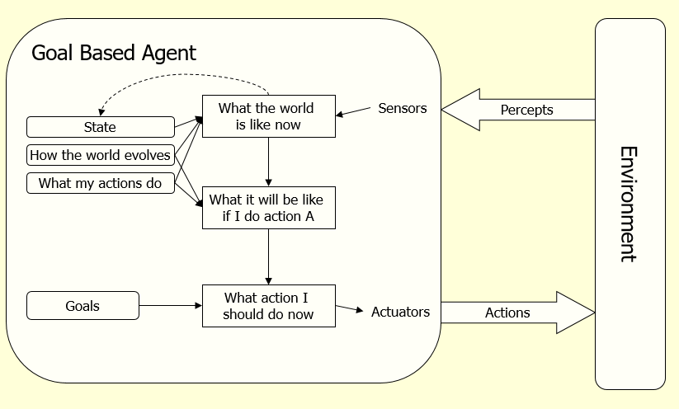
Problem Solving Agents (3)
Function Simple-Problem-Solving-Agent( percept ) returns action
Inputs: percept a percept
Static: seq an action sequence initially empty
state some description of the current world
goal a goal, initially null
problem a problem formulation
state <- UPDATE-STATE( state, percept )
if seq is empty then do
goal <- FORMULATE-GOAL( state )
problem <- FORMULATE-PROBLEM( state, goal )
seq <- SEARCH( problem ) # SEARCH
action <- RECOMMENDATION ( seq ) # SOLUTION
seq <- REMAINDER( seq )
return action # EXECUTION

Slide 7
Goal based Agent(s)
Assumes the problem environment is:
Static
The plan remains the same
Observable
Agent knows the initial state
Discrete
Agent can enumerate the choices
Deterministic
Agent can plan a sequence of actions such that each will lead to an intermediate state
The agent carries out its plans with its eyes closed
Certain of what’s going on
Open loop system

Slide 8
Goal based Agent(s)
Assumes the problem environment is:
Static
The plan remains the same
Observable
Agent knows the initial state
Discrete
Agent can enumerate the choices
Deterministic
Agent can plan a sequence of actions such that each will lead to an intermediate state
The agent carries out its plans with its eyes closed
Certain of what’s going on
Open loop system

Slide 9
Well Defined Problems and Solutions
A problem
Initial state
Actions and Successor Function
Goal test
Path cost

Slide 10
Example: Water Pouring (1)
Given a 4 gallon bucket and a 3 gallon bucket, how can we measure exactly 2 gallons into one bucket?
There are no markings on the bucket
You must fill each bucket completely

Slide 11
Example: Water Pouring (2)
Initial state:
The buckets are empty
Represented by the tuple ( 0 0 )
Goal state:
One of the buckets has two gallons of water in it
Represented by either ( x 2 ) or ( 2 x )
Path cost:
1 per unit step

Slide 12
Example: Water Pouring (3)
Actions and Successor Function
Fill a bucket
(x y) -> (3 y)
(x y) -> (x 4)
Empty a bucket
(x y) -> (0 y)
(x y) -> (x 0)
Pour contents of one bucket into another
(x y) -> (0 x+y) or (x+y-4, 4)
(x y) -> (x+y 0) or (3, x+y-3)

Slide 13
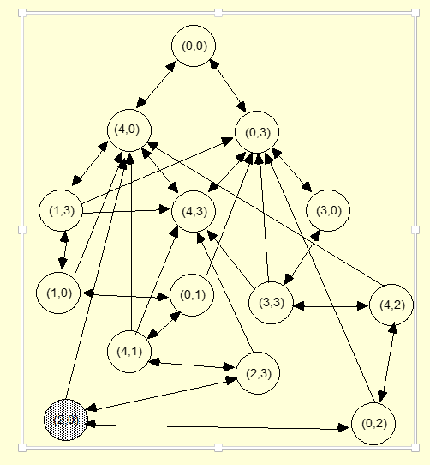
Example: Water Pouring (4)

Slide 14
Learning Outcomes with the Topic
Understanding the need of Search Agent(s)

Slide 15
Methodology And Assessment Criterias
Class Assignment(s)
Each chapter being covered will have one assignment. The Case Studies will be given in line to the Changing with Speed across IT Projects in Kirirom
Internal Exam(s)
There will be 2 exams
Model Exam
There will be one Model Exam.
Semester Exam
There will be 1 Semester Exam

Slide 16
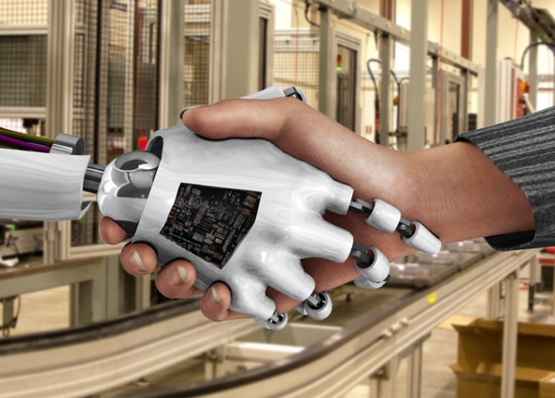
Thank You !
“An Algorithm Must Be Seen to Be Believed”
- Donald Knuth

